Slide 1
Smart fashion advisor
Group - 1

Slide 2
AGENDA
Introduction to Project
User stories
Current Work
Software Architecture
​

Slide 3
Name of the project: Smart Fashion Advisor
Git Hub Repository Link: Here
Introduction:
VISION: FOR individuals WHO prioritize fashion and require expert guidance in selecting clothing and styles THAT will be tailored to their skin tone, physique, and facial structure. THE Fashion Advisor helps in keeping you trendy and original, ensuring you meet your own personal stylist. UNLIKE typical shopping applications that merely recommend popular items, OUR platform serves as a comprehensive destination where you can effortlessly discover the ideal, budget-friendly outfit available from leading websites and physical stores.

Slide 4
User stories
1. As a customer, I want to input my own preferences or choices so that the styles provided reflect my personal selections.
2. As a customer, I want to receive guidance to identify my skin tone, and body shape so that the outfits recommended to me align with my specific facial and body features.
3. As a customer, I want to see or receive outfit recommendations that are tailored to my preferences and input.
4. As a customer, I want access to the contact details of famous influencers so that I can connect with them and receive more personalized suggestions.
5. As a customer, I want to offer feedback about the smart fashion advisor so that the website can become more user-friendly and consider customer suggestions for improvement.
6. As a customer, I want to stay informed about the latest trends, colors, and styles based on the current season or festive occasions so that I can keep myself up-to-date.
7. As a customer, I would like to be redirected to the website where the outfit is available for purchase, saving me time on searching for it.
8. As a customer, I want to utilize my past preferences to receive new styles without the need to re-enter all my details, enhancing the usability and accessibility of the website.

Slide 5
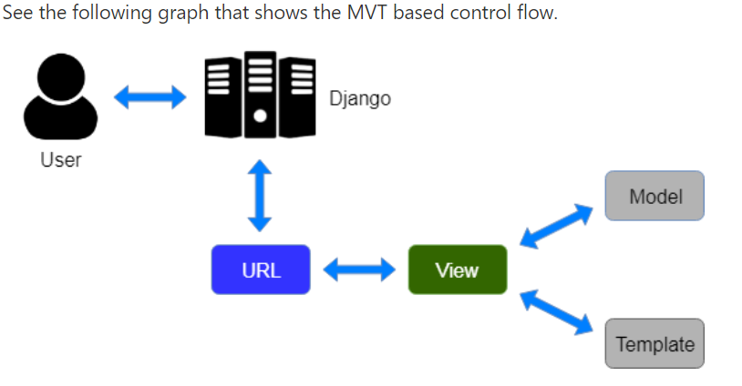
Software Architecture
MVT – MODEL VIEW TEMPLATE

Slide 6
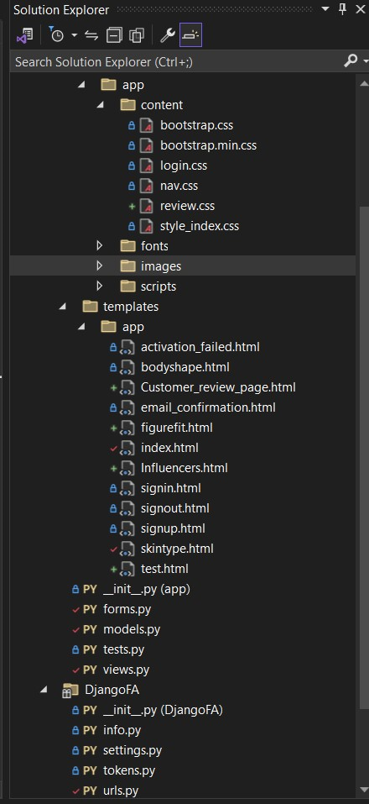




MVT

Slide 7
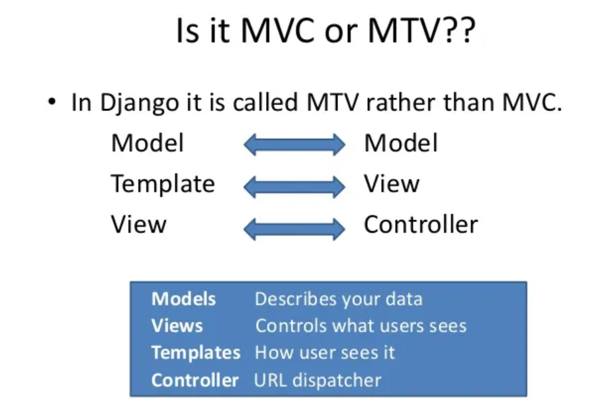
In the MTV pattern:
Model: Just like the Model explanation in the MVC pattern , this also takes the same position as the interface or relationship between the data and contains everything related to data access and validation.
Template: This relates to the View in the MVC pattern as it is the presentation layer that handles the presentation logic in the framework and basically controls what should be displayed and how it should be displayed to the user.
View: This part relates to the Controller in the MVC pattern and handles all the business logic that throws down back to the respective templates. It serves as the bridge between the model and the template

Slide 8
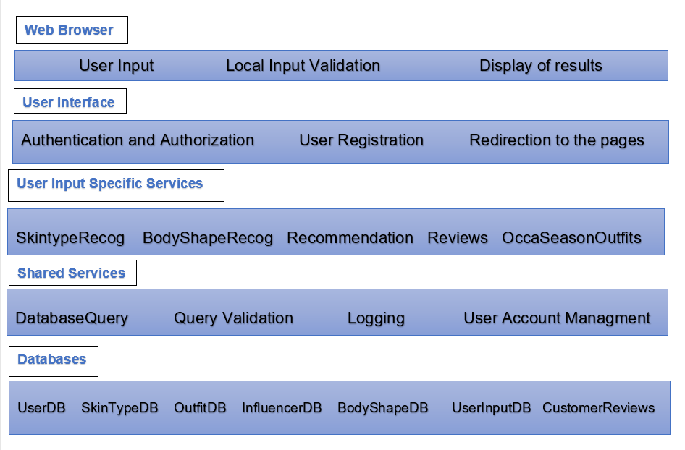
Software Architecture
Layered architecture

Slide 9
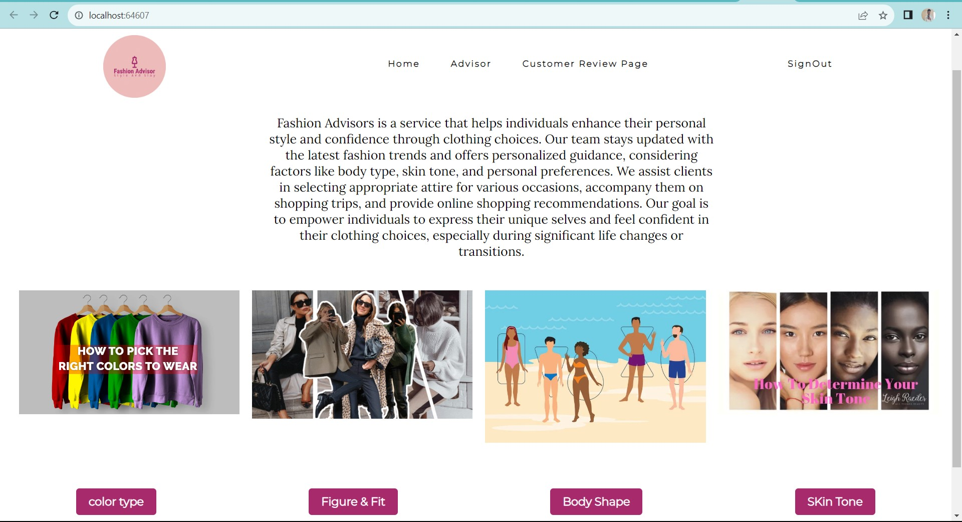
demo

Slide 10
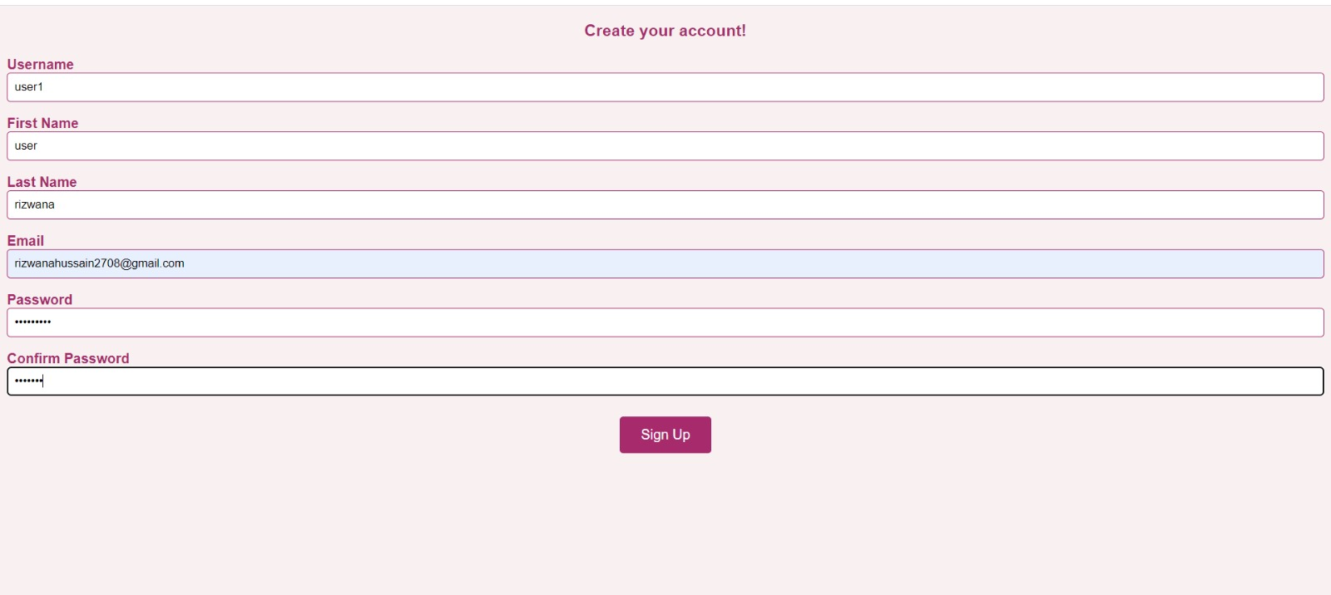
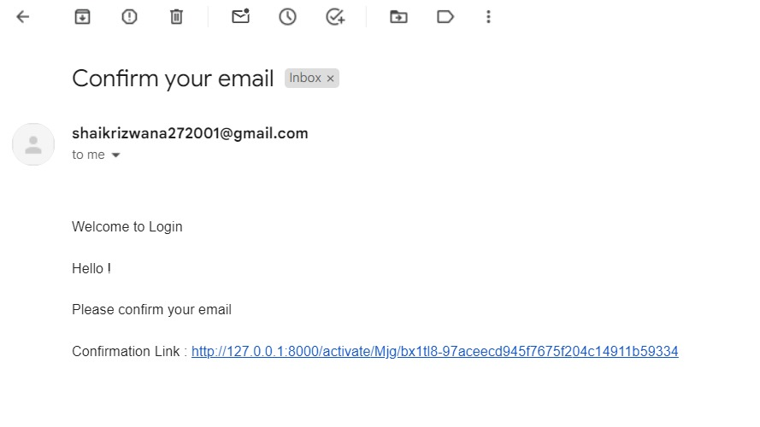
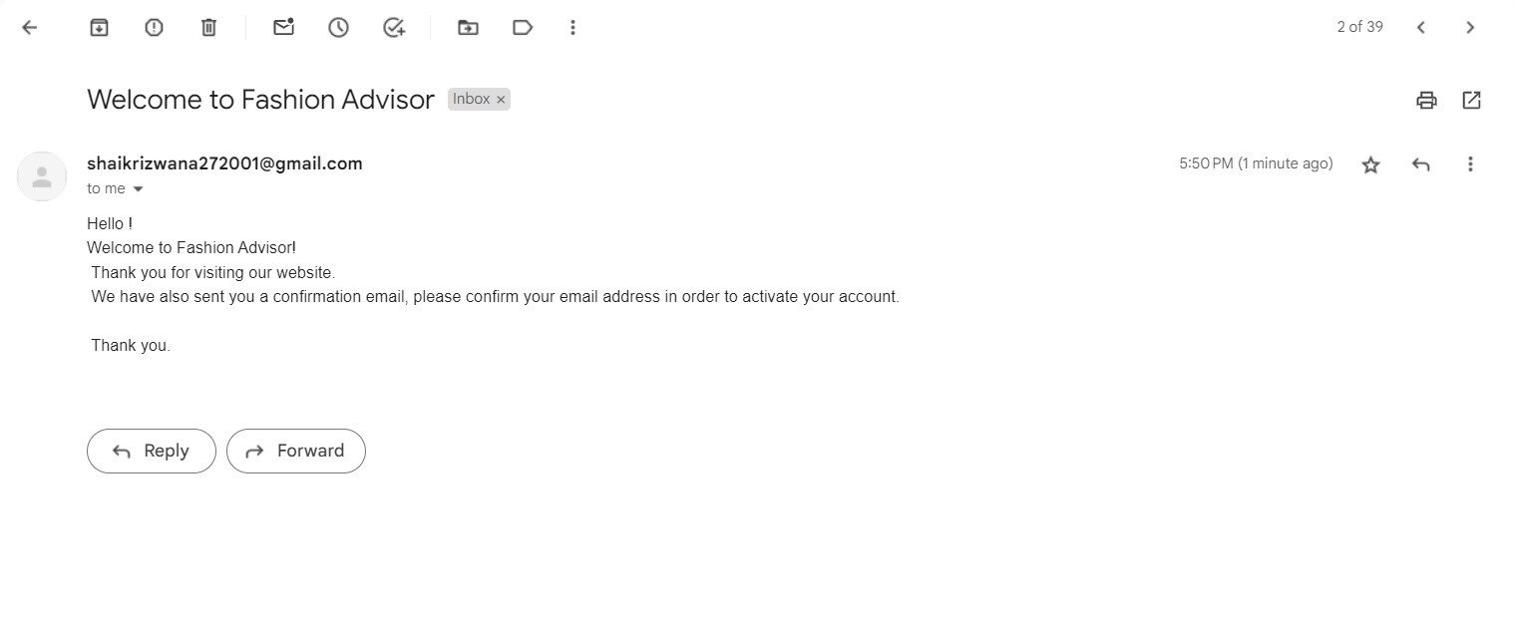
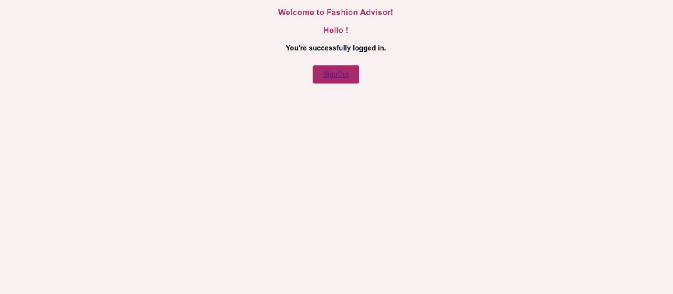
User login and authentication

Slide 11
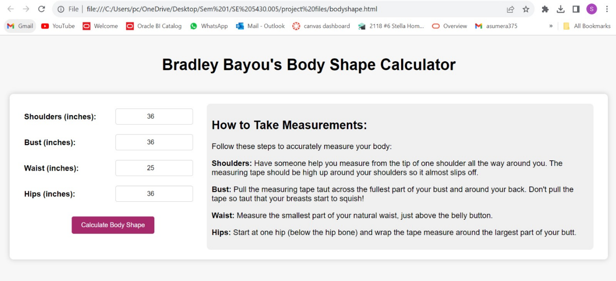
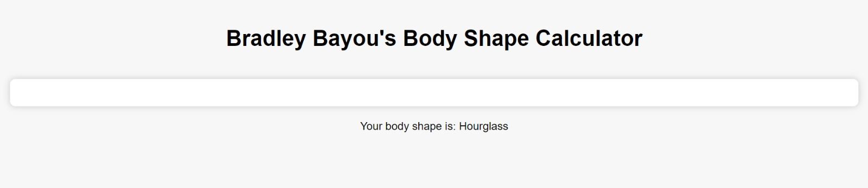
User story: As a customer, I want to receive guidance to identify my skin tone, and body shape so that the outfits recommended to me align with my specific facial and body features.

Slide 12
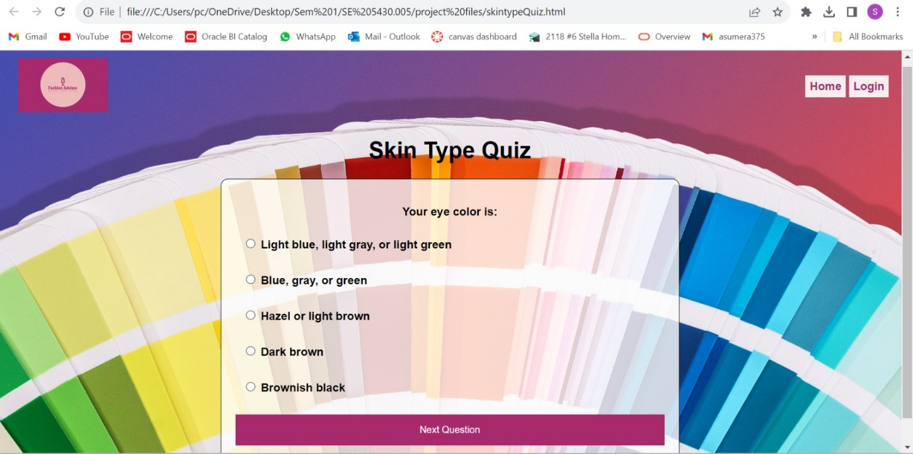
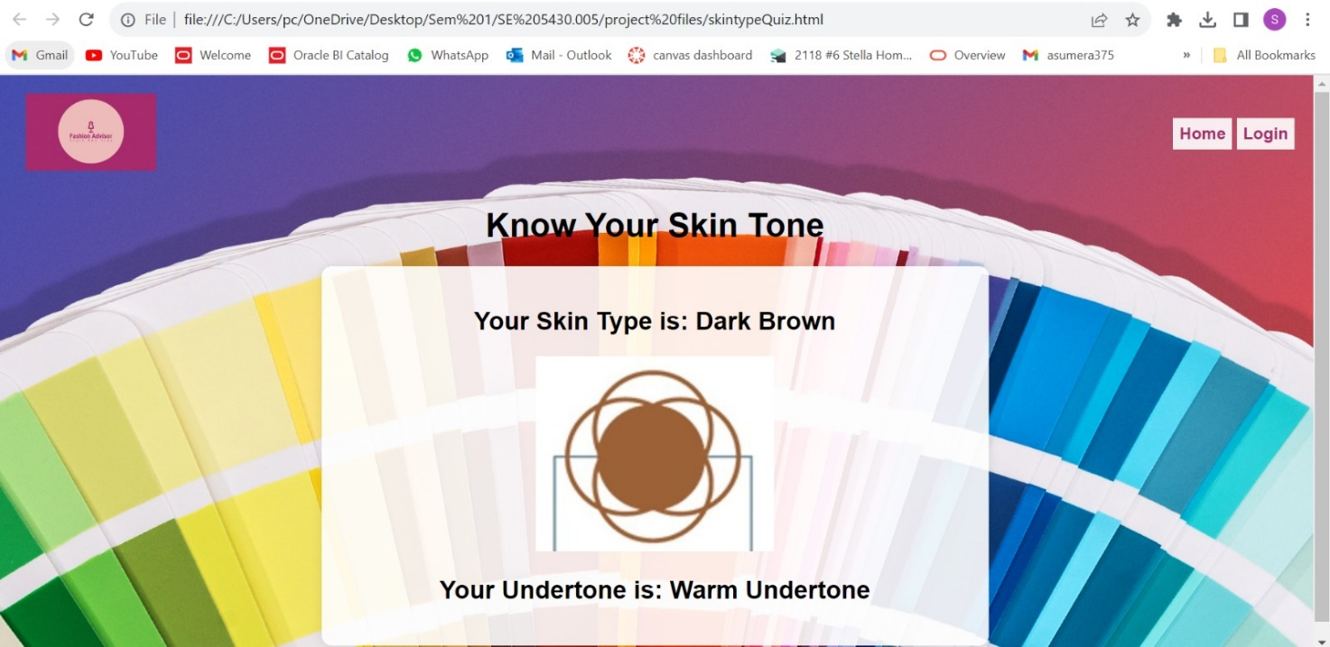
User story: As a customer, I want to receive guidance to identify my skin tone, and body shape so that the outfits recommended to me align with my specific facial and body features.

Slide 13
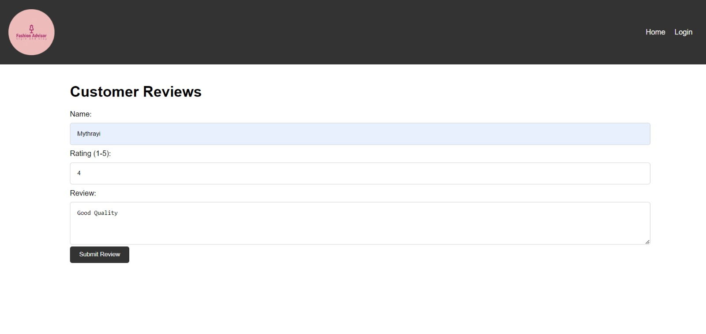
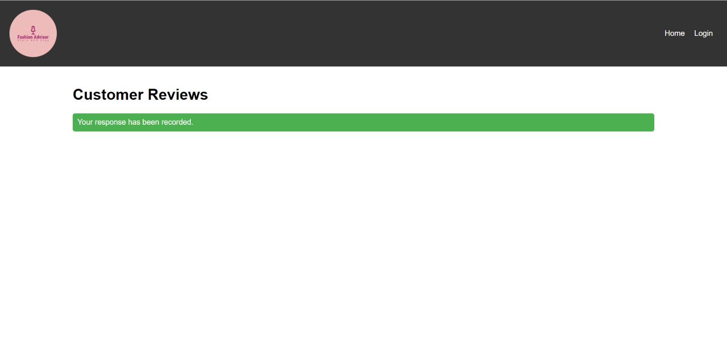
User story #5: We collect the customer reviews and store them into our database which helps in improving the performance.

Slide 14
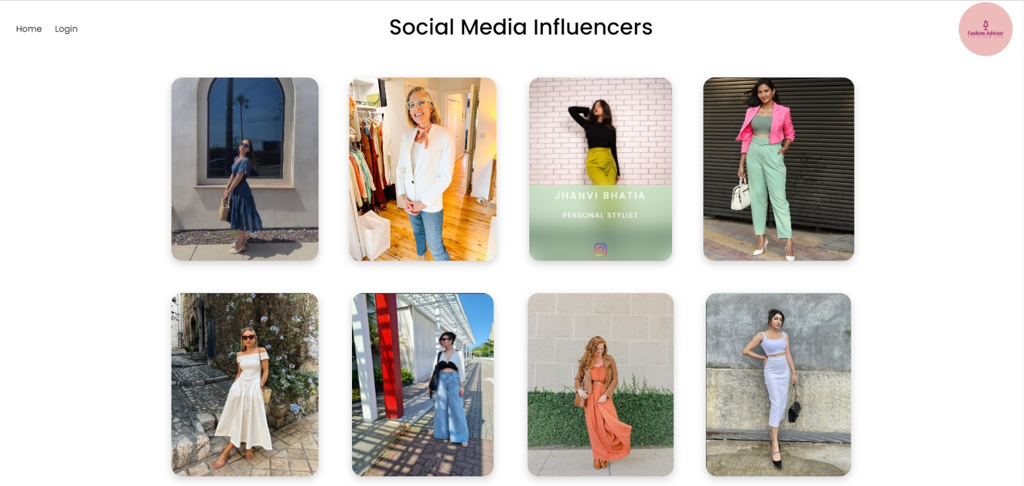
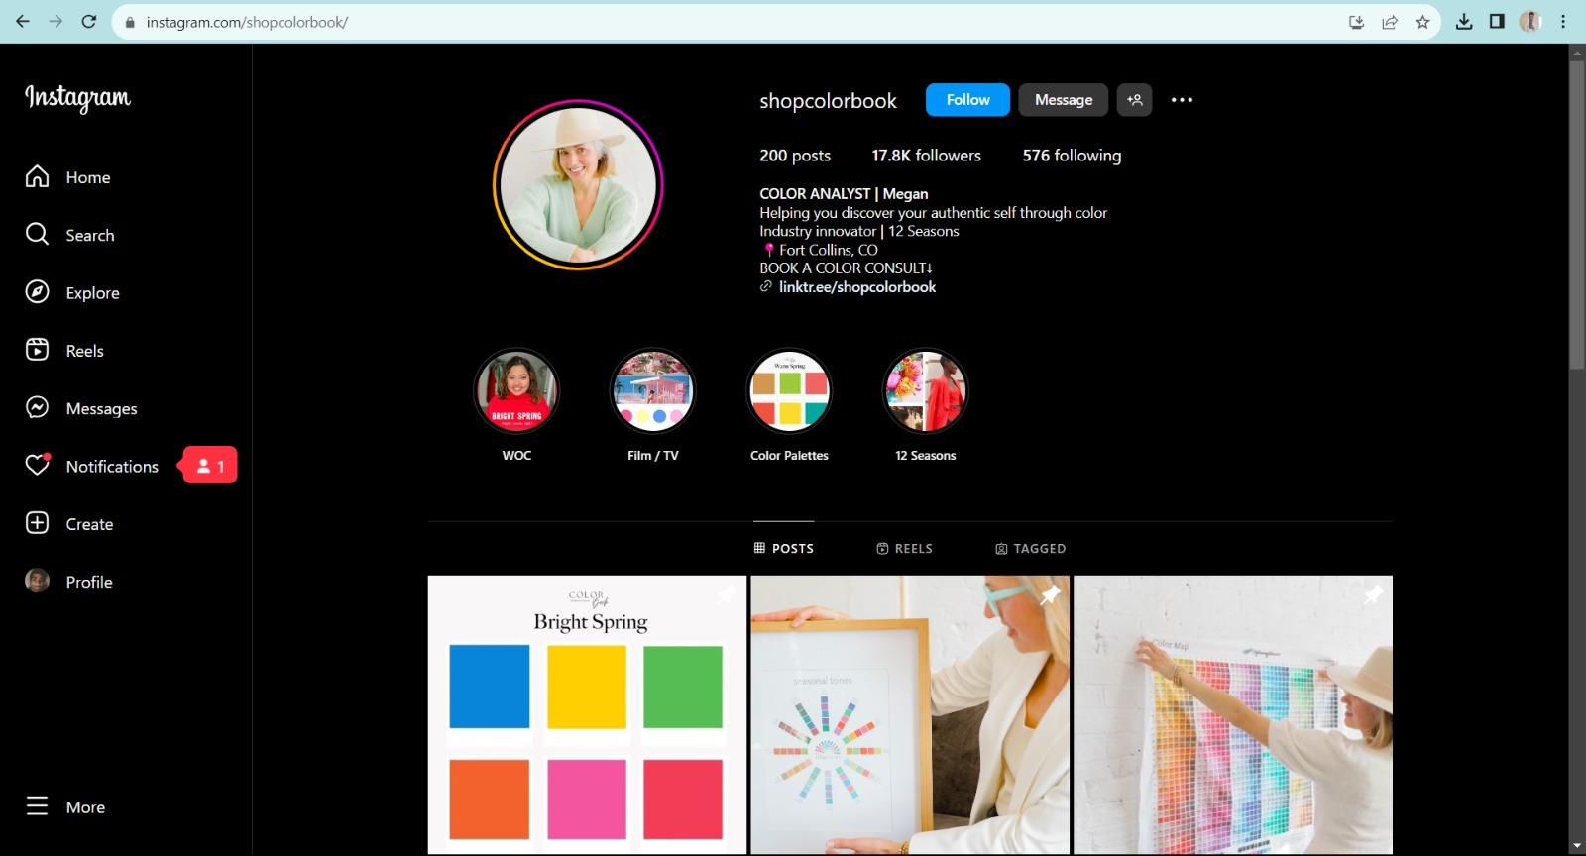
User story #4: Here are the influencers who can help the customers with styling advises. We also redirect the customer to their Instagram page.

Slide 15
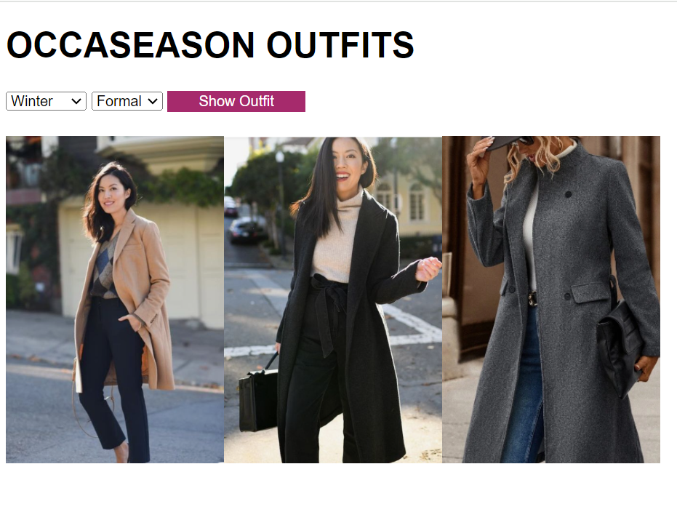
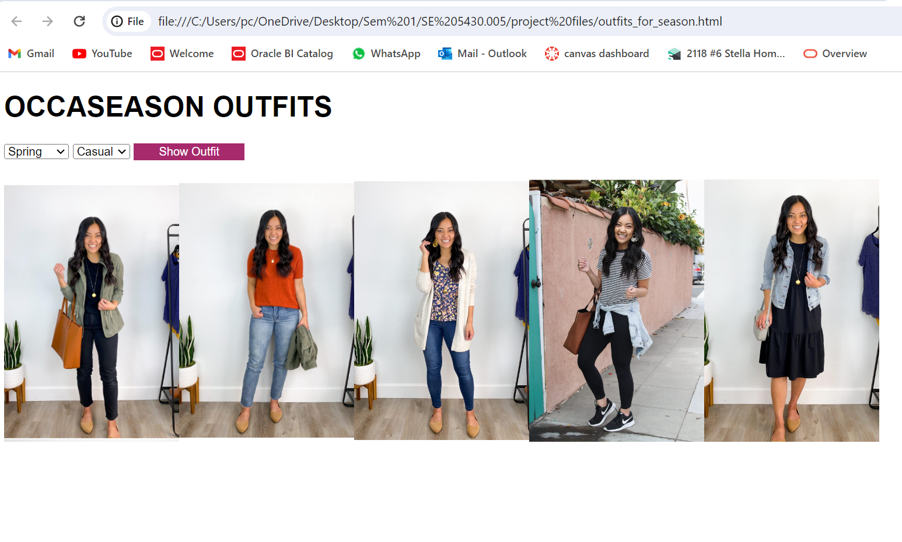
User story #6:Here is the page for displaying the outfits according to the occasion and season. This help user to get inspiration for their everyday life.

Slide 16
THANK YOU

